Slide 1
Analysis of New York Citi Bikes
BY daniel c. sam-nwuche

Slide 2
Project Goal
To better understand the behavior of New York Citi Bike’s customer base (both one-time users and subscribers) and how they use New York Citi Bikes.
This will help to:
Identify where more bikes should be installed
Create more targeted marketing campaigns that will appeal to different customer age groups

Slide 3
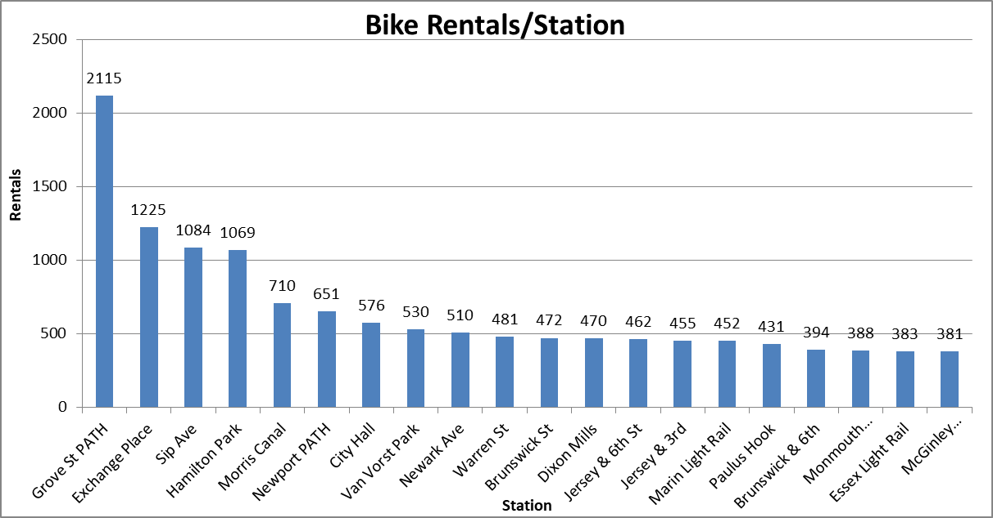
What are the most popular Citi Bike pick-up locations?

Slide 4
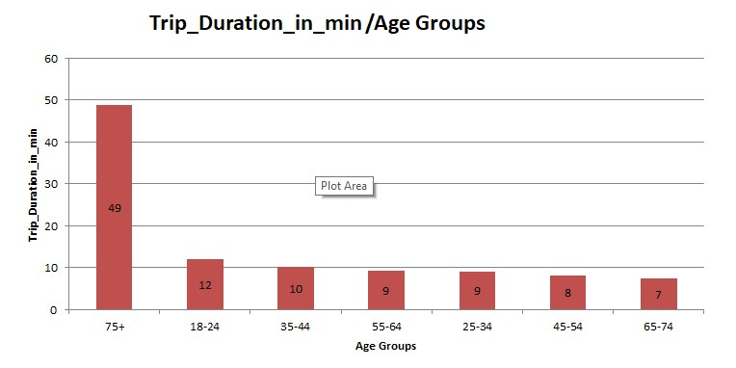
How does the average trip duration vary across different age groups?

Slide 5
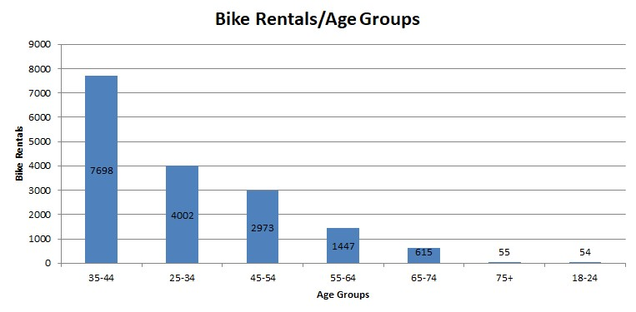
Which age groups rents the most bikes?

Slide 6
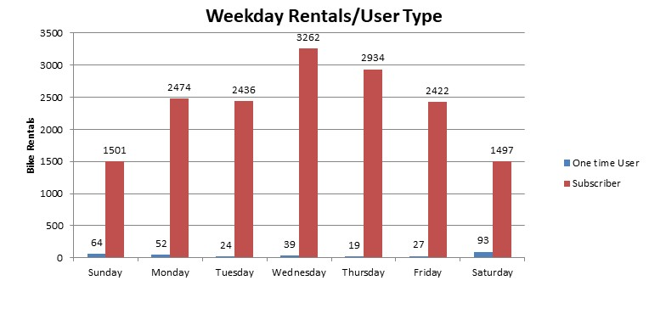
How does bike rental vary across the two user groups (one-time users vs long-term subscribers) on different days of the week?

Slide 7
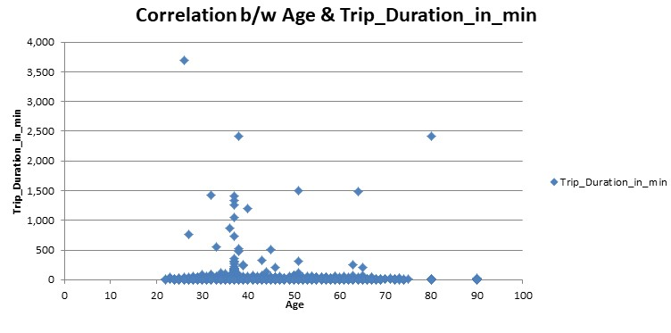
Does the factor of age impact the average bike trip duration?
There was no correlation between user age and trip duration

Slide 8
Summary of the Findings
Top 5 pick-up locations for bikes:
Grove St Path
Exchange Place
Sip Ave
Hamilton Park
Morris Canal
Customer Base:
Long-term subscribers who are more active during the week
One-time users are more active at weekends
Most bikes rented by 35-44 year olds

Slide 9
Summary of the Findings
New York Citi Bike customer behavior:
75+ year olds take longest average trips, but rent the least bikes
65-74 and 25-34 year olds take the shortest average trips

Slide 10
Recommended Actions
Product recommendations:
Install more bikes at Grove St Path, Exchange Place, Sip Ave, Hamilton Park, Morris Canal
Marketing recommendations:
The Citi Bike customer base is mostly long-term subscribers aged between 35-44,who are most active during the week. Marketing and advertising campaigns should be set up to target this particular demographic.

Slide 11
Thank You !!

